Slide 1
Applied Natural Language Processing
Dr. Sucharitha Shetty

Slide 2
Table of Contents
Word2Vec

Slide 3
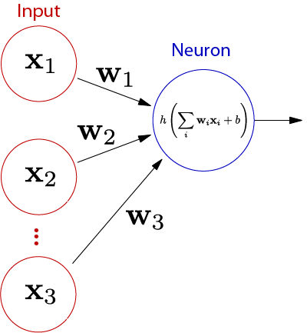
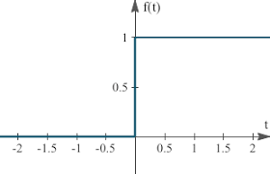
Artificial neuron [Perceptron]
Weighted sum:
x1w1 + x2w2 + x3w3
= 0.2*-0.3 + 0.4*0.4 + 0.6*-0.8
= -0.06+0.16-0.48
= -0.38
Y= f(x1w1 + x2w2 + x3w3)
= f(-0.38) = 0
New output
Y= f(x1w1 + x2w2 + x3w3+b)
Y=f(-0.38+ 0.5)
Y=f(0.12) = 1
Suppose inputs,
x1= 0.2, x2=0.4, x3=0.6, b=0.5
And weights
W1= -0.3, w2= 0.4, w3= -0.8
Activation function:
Step Function (threshold)
1 if wixi > 0
and
0 if wixi ≤ 0

Slide 4
Perceptron
Single Layer Perceptron Model: Used for Linear Seperable Problem .
Not suitable for non-linear seperable data
Multi Layer Perceptron Model[ANN]

Slide 5
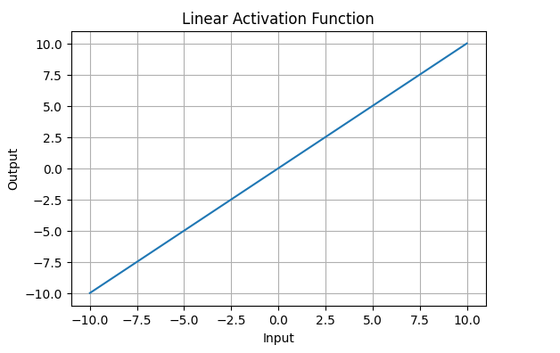
Types of Activation Functions in Deep Learning
1. Linear Activation Function
Linear Activation Function resembles straight line define by y=x.
The range of the output spans from (−∞ to +∞.
Linear activation function is used at just one place i.e. output layer.
Using linear activation across all layers makes the network's ability to learn complex patterns limited.
Linear activation functions are useful for specific tasks but must be combined with non-linear functions to enhance the neural network’s learning and predictive capabilities.

Slide 6
Linear Activation Function
A linear activation function is the simplest type of activation, where the output is directly proportional to the input. The function is:f(x) = x or f(x) = wx + bwhere w is a weight and b is a bias.Key CharacteristicsIn the context of neural networks for NLP, linear activations simply pass the weighted sum of inputs through unchanged (or with a simple scaling). They don't introduce any non-linearity into the model.
Example in NLP: Sentiment AnalysisLet's say you're building a simple sentiment classifier for movie reviews. Here's how a linear activation might work:
Input: "This movie was great" → converted to word embeddings → [0.2, 0.5, -0.1, 0.8]Linear Layer Processing:Weighted sum: (0.2 × 1.5) + (0.5 × 0.8) + (-0.1 × -0.5) + (0.8 × 2.0) = 2.35Linear activation: f(2.35) = 2.35Output: 2.35 (which might represent a positive sentiment score)

Slide 7
Linear Activation Function
Why Linear Activations Are Limited in NLP:Linear activations have a critical limitation: no matter how many layers you stack, the entire network remains equivalent to a single-layer model. This is because composing linear functions still gives you a linear function.
For NLP tasks like language modeling, translation, or complex text classification, you need to capture non-linear patterns in language (idioms, context-dependent meanings, grammatical structures). That's why modern NLP models use non-linear activations like ReLU, GELU, or tanh in hidden layers.
Common use case: Linear activations are typically used in the final output layer of NLP models for regression tasks (like predicting a continuous sentiment score) or before applying softmax for classification.

Slide 8
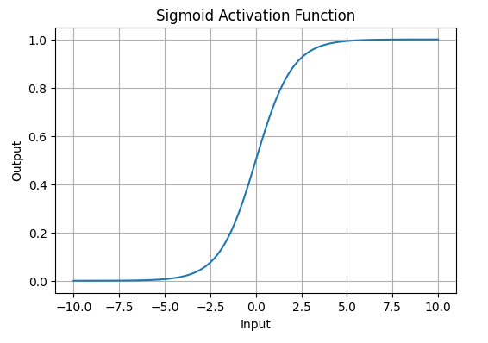
Non-Linear Activation Functions
1. Sigmoid Activation Function: is characterized by 'S' shape. It is mathematically defined as
This formula ensures a smooth and continuous output that is essential for gradient-based optimization methods.
It allows neural networks to handle and model complex patterns that linear equations cannot.
The output ranges between 0 and 1, hence useful for binary classification.
.

Slide 9
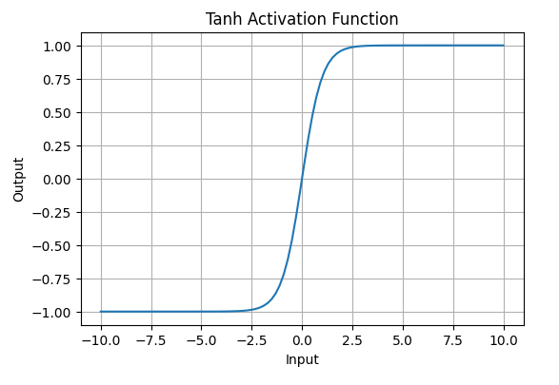
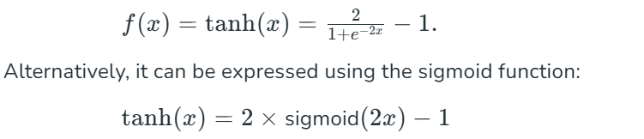
2. Tanh Activation Function
Tanh function (hyperbolic tangent function) is a shifted version of the sigmoid, allowing it to stretch across the y-axis. It is defined as:
Value Range: Outputs values from -1 to +1.
Non-linear: Enables modeling of complex data patterns.
Use in Hidden Layers: Commonly used in hidden layers due to its zero-centered output, facilitating easier learning for subsequent layers.

Slide 10
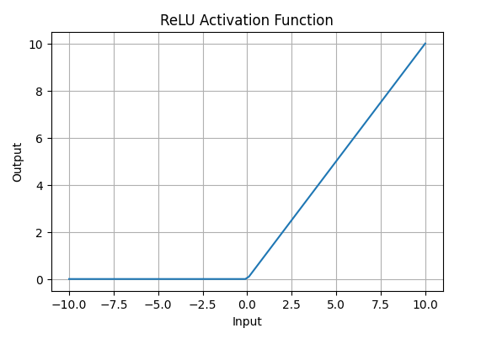
3. ReLU (Rectified Linear Unit) Function
ReLUactivation is defined by A(x)=max⁡(0,x), this means that if the input x is positive, ReLU returns x, if the input is negative, it returns 0.
Value Range: [0,∞), meaning the function only outputs non-negative values.
Nature: It is a non-linear activation function, allowing neural networks to learn complex patterns and making backpropagation more efficient.
Advantage over other Activation: ReLU is less computationally expensive than tanh and sigmoid because it involves simpler mathematical operations. At a time only a few neurons are activated making the network sparse making it efficient and easy for computation.

Slide 11
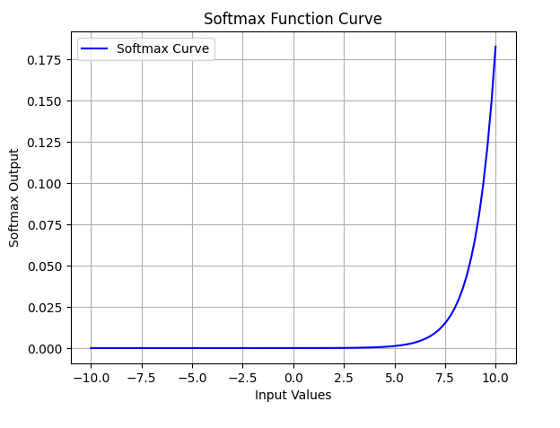
Exponential Linear Units
1. Softmax Function
Softmaxfunction is designed to handle multi-class classification problems. It transforms raw output scores from a neural network into probabilities. It works by squashing the output values of each class into the range of 0 to 1 while ensuring that the sum of all probabilities equals 1.
Softmax is a non-linear activation function.
The Softmax function ensures that each class is assigned a probability, helping to identify which class the input belongs to.

Slide 12
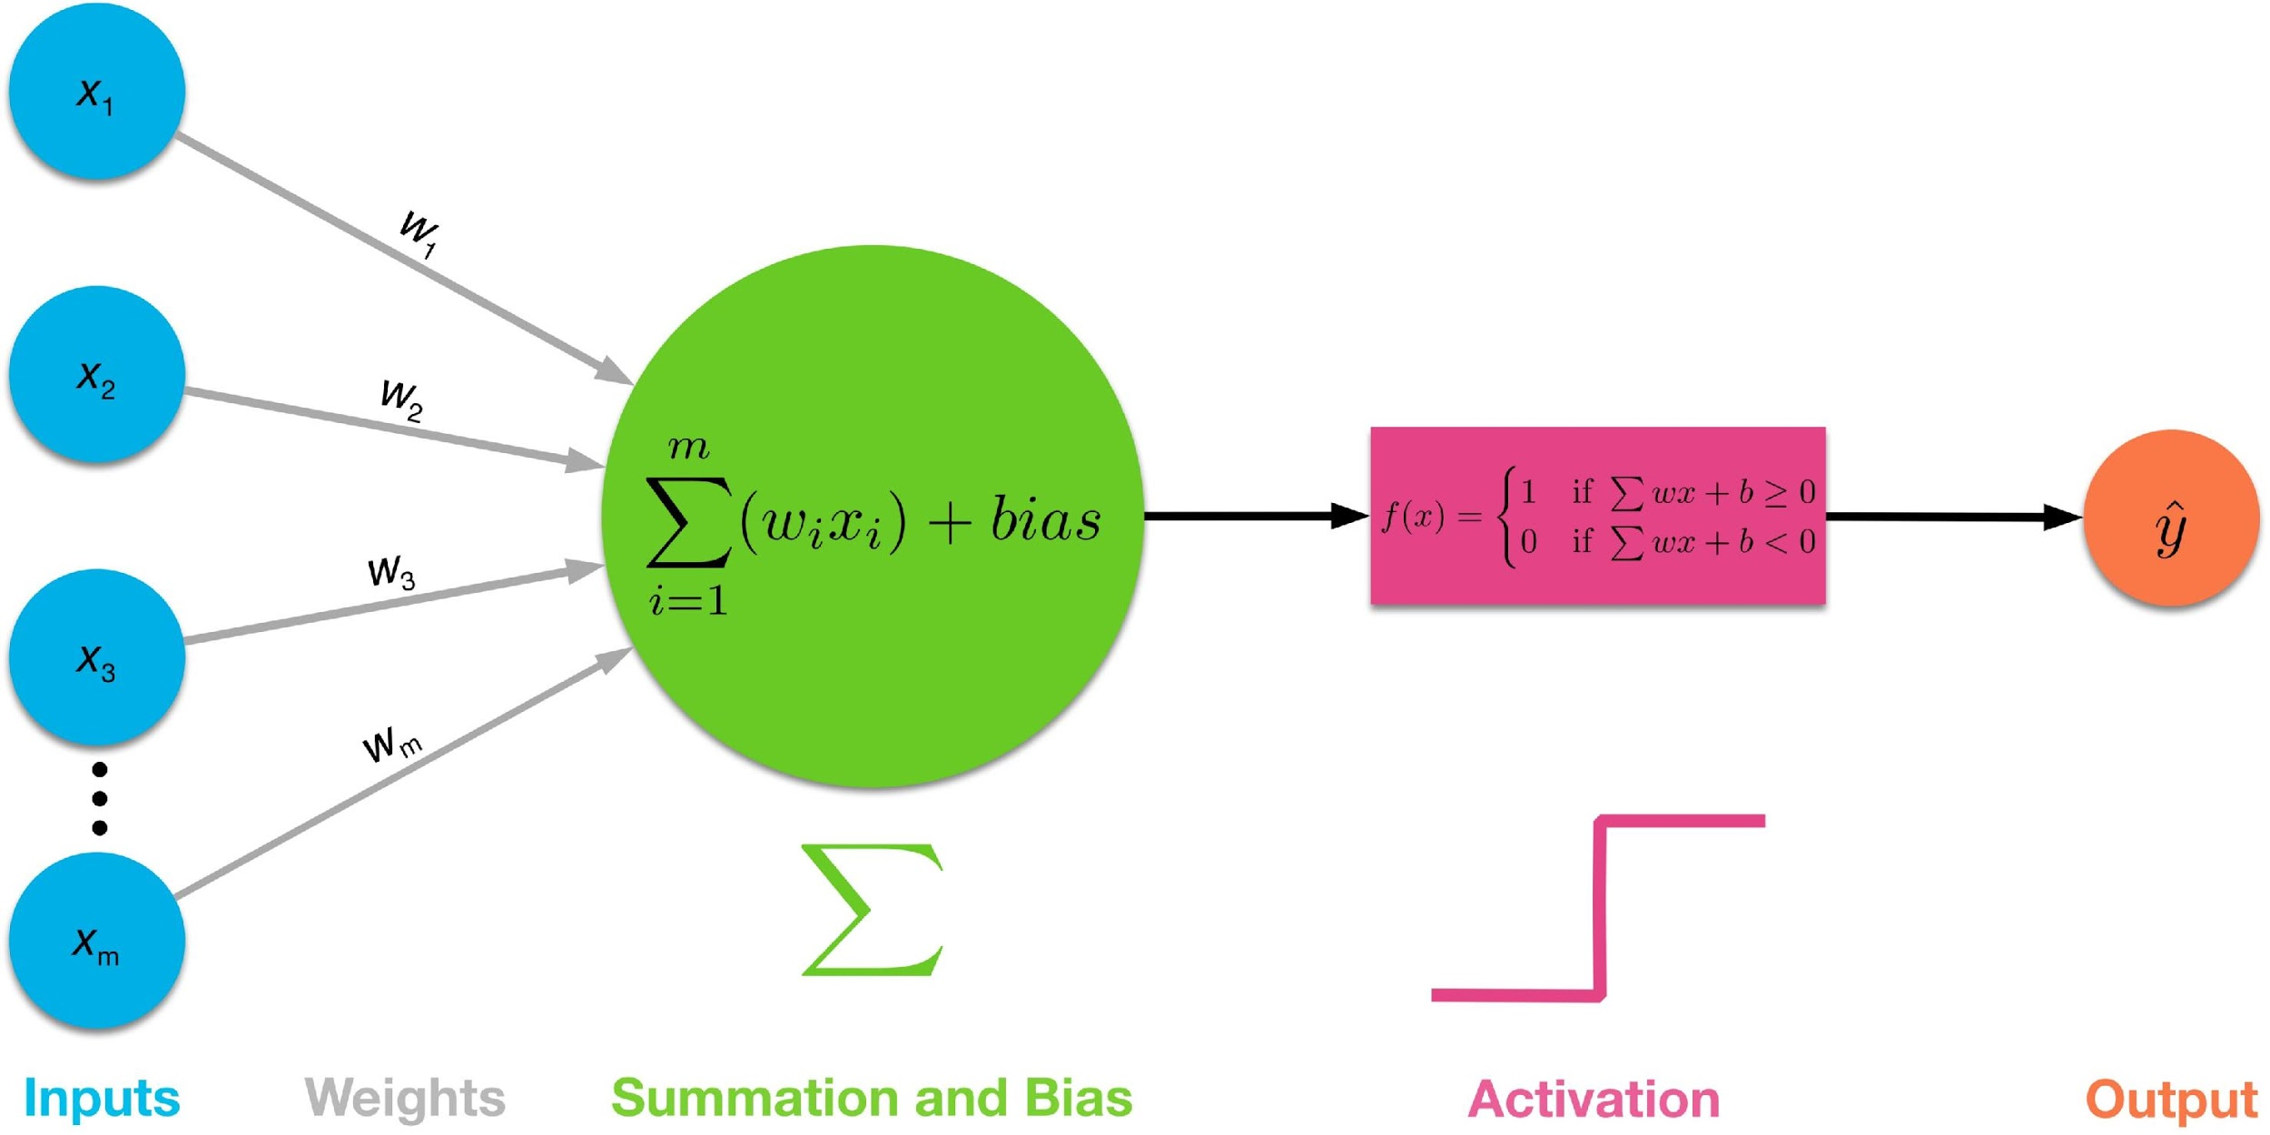
Perceptron
A perceptron is a fundamental building block in neural networks, designed to mimic the function of a biological neuron. It's a simple model that takes multiple inputs, assigns weights to them, sums them up, and then applies an activation function to produce a binary output (0 or 1).
In the equation given above:
  “w” = vector of real-valued weights
  “b” = bias (an element that adjusts the boundary away from origin without any dependence on the input value)
  “x” = vector of input x values
  “f” = activation function that decides whether a neuron will fire or not based on threshold

Slide 13
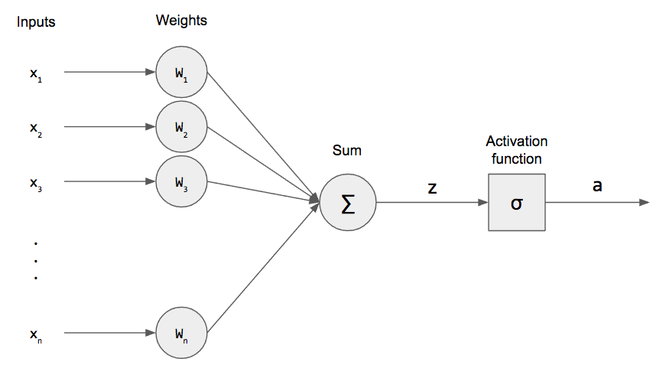
Perceptron network learning
Use perceptron network to learn any function.
Learning process of any neural network has following steps:
  Initialize weight values and bias
  Forward Propagate
  Check the error
  Backpropagate and Adjust weights and bias
  Repeat for all training examples

Slide 14
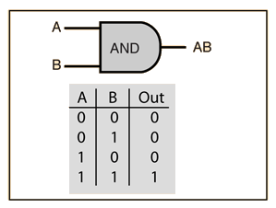
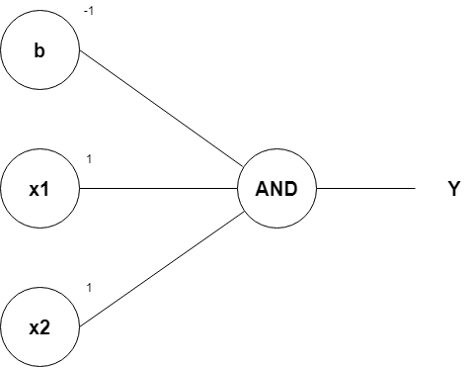
“And Gate” implementation using perceptron
Row 1
From w1*x1+w2*x2+b, initializing w1, w2, as 1 and b as –1, we get;
x1(1)+x2(1)–1
Passing the first row of the AND logic table (x1=0, x2=0), we get;
0+0–1 = –1
From the Perceptron rule, if Wx+b≤0, then y`=0.
Therefore, this row is correct, and no need for Backpropagation.

Slide 15
“And Gate” implementation using perceptron
Row 2 and Row 3
Passing (x1=0 and x2=1), we get;
0+1–1 = 0
From the Perceptron rule, if Wx+b≤0, then y`=0. This row is correct, as the output is 0 for the AND gate.
From the Perceptron rule, this works (for both row 1, row 2 and 3).

Slide 16
“And Gate” implementation using perceptron
Row 4
Passing (x1=1 and x2=1), we get;
1+1–1 = 1
Again, from the perceptron rule, this is still valid
Therefore, we can conclude that the model to achieve an AND gate, using the Perceptron algorithm is;
    x1+x2-1

Slide 17
OR Function
X₁ | X ₂ | y
0 | 0 | 0
0 | 1 | 1
1 | 0 | 1
1 | 1 | 1
X ₂
1
1
X₁  X ₂  0.5  0
1
0
X₁

Slide 18
OR Function
1 0
1 0
1 1
1 1 1
 0.5
0
₁
^{0}  0.5
₁ 

 0.5 
 
⇒  
X ^{t}W  
 
1
1
  
0 
 0.5 
 1.5 
1

 

 
 

¹

Slide 19
XOR Function
X₁ | X ₂ | y
0 | 0 | 0
0 | 1 | 1
1 | 0 | 1
1 | 1 | 0
X ₂
1
0
0
1
X₁

Slide 20
XOR Function
X₁  X ₂  ( X₁  X ₂ ).( X₁  X ₂ )
X₁ | X ₂ | h₁  X₁  X ₂ | h₂  X₁  X ₂ | h₁.h₂  X₁  X ₂
0 | 0 | 0 | 1 | 0
0 | 1 | 1 | 1 | 1
1 | 0 | 1 | 1 | 1
1 | 1 | 1 | 0 | 0

Slide 21
XOR Function
_{1 } 1 1 1 1
0 1 1  
1 0
X
 0.5 1
 1.5 1
 0.5
0.5 0.5 1.5 
0.5 0.5  0.5
0 1 1 1
1 1 1 0

 ₀
 
⇒ 

1 

 1.5
0
1
_{W} t
h
1
1 0
 1
1 1
1 1 0
 0.5
^{1} 1.5
0
₁
₁ 
 0.5 
 
1
1

t
 
  

⇒
h W 
 0.5 
0.5
⇒
¹
1
2
1

 

 

 
⁰
X₁  X ₂

Slide 22
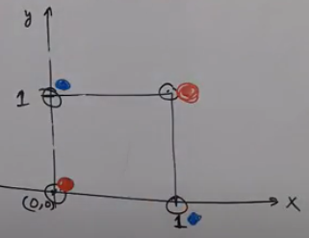
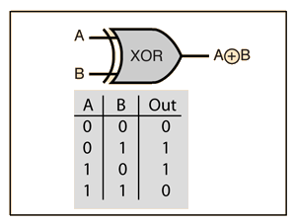
“XOR Gate” implementation using perceptron
Single perceptron can not implement XOR gate

Slide 23
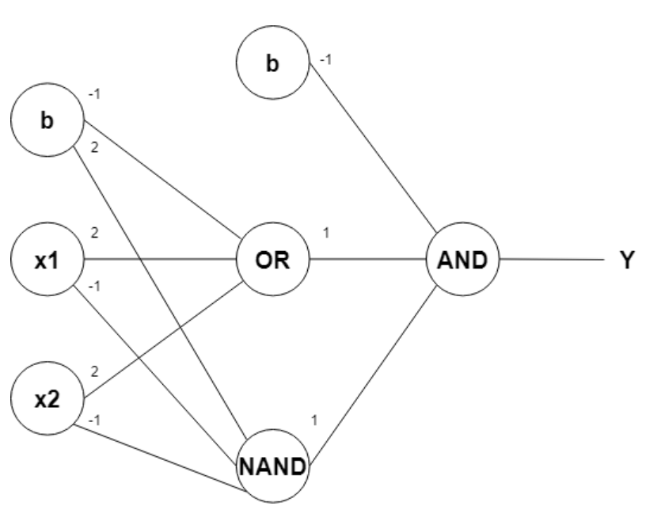
“XOR Gate” implementation using perceptron
Two perceptrons to implement XOR gate

Slide 24
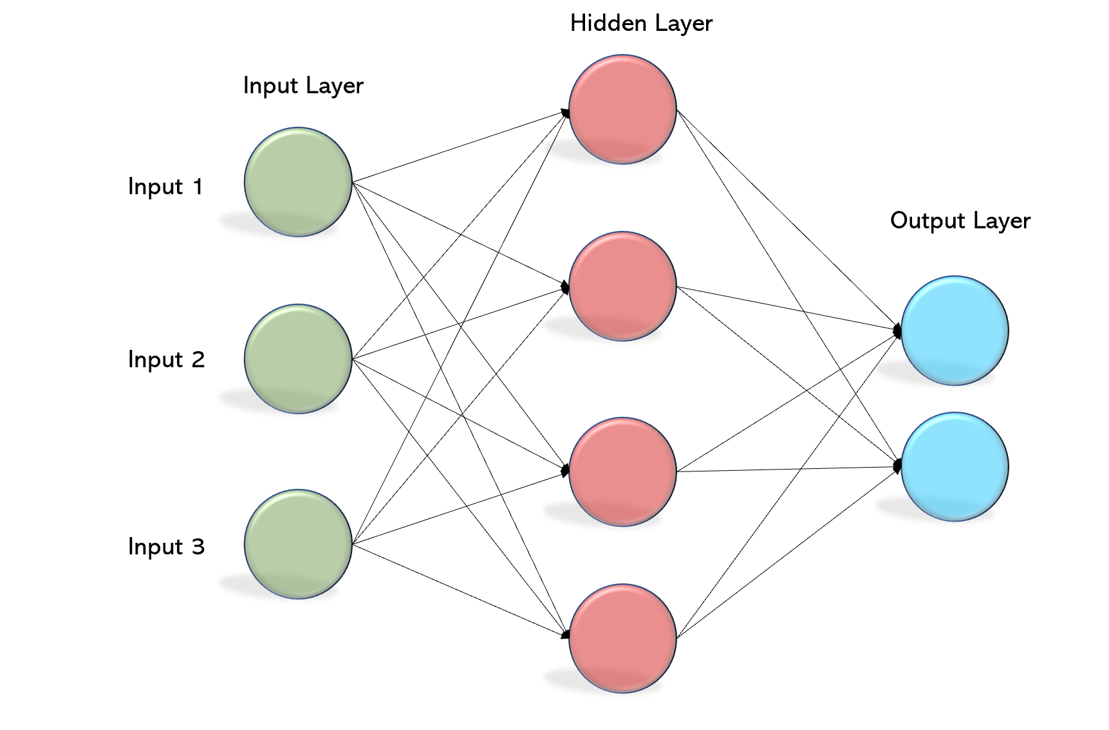
Multilayer perceptron network (fully connected network)

Slide 25
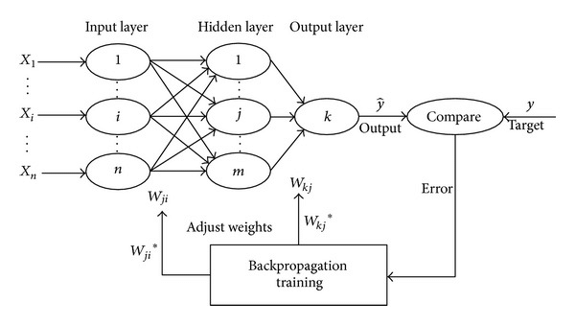
Multilayer perceptron network (fully connected network)

Slide 26
Formal definition of Deep Learning
There is no any specific definition of deep learning. Different sources have given different definition of deep learning.
Layered view:
  If number of layers in ANN will be more than two, then that network is termed as “Deep Network”.
  In deep learning, the process of creating and selecting features from the data is done automatically by the neural network itself, rather than requiring manual intervention or human-designed features.
Feature Extraction View:
  In deep learning, the feature engineering is automatic.,
Wikipedia Says, “Deep learning is part of a broader family of machine learning methods based on artificial neural networks with representation learning”.
“Learning can be supervised, semi-supervised or unsupervised”.

Slide 27
Thank You

